Slide 1


Introduction on Your C++ Journey
Welcome to your introduction to C++! This course will guide absolute beginners through the fundamentals of C++ programming.
Discover key concepts, essential tools, and valuable resources to kickstart your coding adventure.
by Suwat Tae

Slide 2

Foundational Learning Resources
Modern C++ for Absolute Beginners
Problem Solving with C++
Start with fundamental C++ concepts.
Enhance your logical thinking.
A beginner-friendly introduction.
Practical application of theory.
Download PDF
Download PDF
https://github.com/taesuwat1/C-Course

Slide 3

Essential Online Platforms
W3Schools for C++
GitHub for Projects
Interactive C++ tutorials.
Host your code repositories.

Slide 4
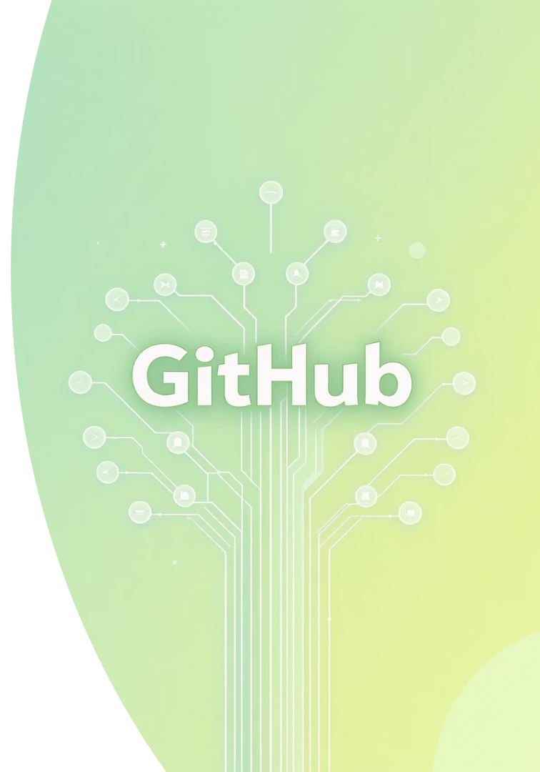
Leveraging GitHub Ecosystem
GitHub.com
Collaborate on coding projects.
Version control for your work.
Visit GitHub
GitHub Copilot
AI-powered code suggestions.
Boost your coding efficiency.
Explore Copilot features

Slide 5




AI Tools for Enhanced Coding
ChatGPT
Generative AI for code and concepts.
Access ChatGPT
Gemini
Google's advanced AI assistant.
Try Gemini
MS Copilot
Integrated AI for Microsoft products.
Use MS Copilot

Slide 6



Advanced AI Integration
Microsoft 365 Copilot
AI in your productivity suite.
Learn more
GitHub Copilot for Developers
Directly assists coding tasks.
GitHub Copilot details

Slide 7

Practice with Source Codes
Download Source Codes
Access examples from the book.
Get Source Codes
Experiment and Modify
Change code, observe outcomes.
Debug and Troubleshoot
Learn problem-solving hands-on.

Slide 8

Key Takeaways & Next Steps
1
2
3
Start Basic
Use Online Resources
Embrace AI Tools
Begin with beginner-friendly books.
Leverage AI for efficiency.
W3Schools and GitHub are vital.
4
Practice Regularly
Hands-on coding is crucial.

